Slide 1

What is the TEI and Why Should I Care?
Joey Takeda
September 20th, 2018
UBC DH Pixelating Mixer

Slide 2
Hi!
Joey Takeda, MA Student, Dept. of English Language and Literatures (Science and Technology Studies Program)
Undergrad in English Honours and Gender Studies @ Uvic
Digital Humanities programmer for projects such as The Map of Early Modern London, Linked Early Modern Drama Online, and The Endings Project
Specialize in TEI, XHTML, and Digital Humanities project development
https://github.com/joeytakeda
This workshop: https://github.com/joeytakeda/teiworkshop

Slide 3
This Workshop

Slide 4
This Workshop
Brief conceptual introduction to encoding, XML, and TEI

Slide 5
This Workshop
Brief conceptual introduction to encoding, XML, and TEI
Examples of projects that use the TEI

Slide 6
This Workshop
Brief conceptual introduction to encoding, XML, and TEI
Examples of projects that use the TEI
Pointers to further resources on learning about the TEI

Slide 7
This Workshop
Brief conceptual introduction to encoding, XML, and TEI
Examples of projects that use the TEI
Pointers to further resources on learning about the TEI
Next workshop will focus on tools and resources for creating a TEI project (October 25)

Slide 8

Text Encoding and the TEI

Slide 9
Encoding, markup, et cetera…

Slide 10
Encoding, markup, et cetera…
At its core, textual encoding is a way of identifying and differentiating bits of text from other bits of texts.

Slide 11
Encoding, markup, et cetera…
At its core, textual encoding is a way of identifying and differentiating bits of text from other bits of texts.
We do this all the time!

Slide 12
Encoding, markup, et cetera…
At its core, textual encoding is a way of identifying and differentiating bits of text from other bits of texts.
We do this all the time!
Italics for emphasis

Slide 13
Encoding, markup, et cetera…
At its core, textual encoding is a way of identifying and differentiating bits of text from other bits of texts.
We do this all the time!
Italics for emphasis
Underlining for titles

Slide 14
Encoding, markup, et cetera…
At its core, textual encoding is a way of identifying and differentiating bits of text from other bits of texts.
We do this all the time!
Italics for emphasis
Underlining for titles
Bold for extra-emphasis

Slide 15
Encoding, markup, et cetera…
At its core, textual encoding is a way of identifying and differentiating bits of text from other bits of texts.
We do this all the time!
Italics for emphasis
Underlining for titles
Bold for extra-emphasis
Quotation marks for “outside attribution” or “skepticism”

Slide 16
Encoding, markup, et cetera…
At its core, textual encoding is a way of identifying and differentiating bits of text from other bits of texts.
We do this all the time!
Italics for emphasis
Underlining for titles
Bold for extra-emphasis
Quotation marks for “outside attribution” or “skepticism”
All capitals to YELL

Slide 17
Encoding, markup, et cetera
But these are contextual and local

Slide 18
Encoding, markup, et cetera
But these are contextual and local
E.g. different types of punctuation for levels of quotation

Slide 19
Encoding, markup, et cetera
But these are contextual and local
E.g. different types of punctuation for levels of quotation
And they are subject to varying interpretations
E.g. I think these quotation marks denote a term, but maybe the author is just being sarcastic…

Slide 20
Why should we encode texts?

Slide 21
Why should we encode texts?
Computer-readable
Flexibility
Interoperability
Convertibility (i.e. from one format to another)
Output ≠ Input
+++

Slide 22
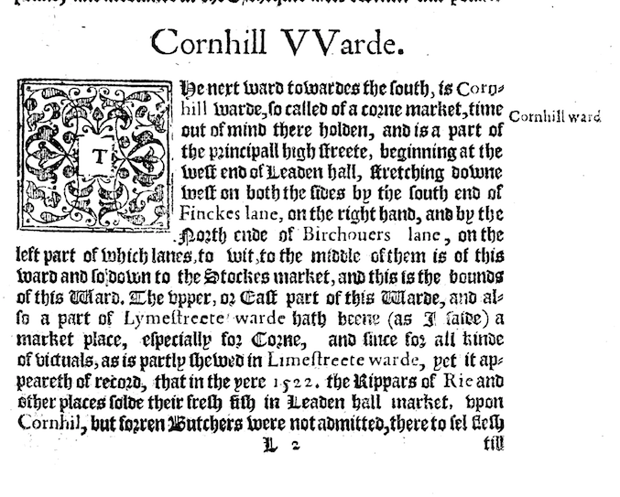
Stow’s Survey of London

Slide 23
Stow’s Survey of London

Slide 24
Stow’s Survey of London

Slide 25
Stow’s Survey of London

Slide 26
Stow’s Survey of London

Slide 27
Stow’s Survey of London

Slide 28
Stow’s Survey of London

Slide 29
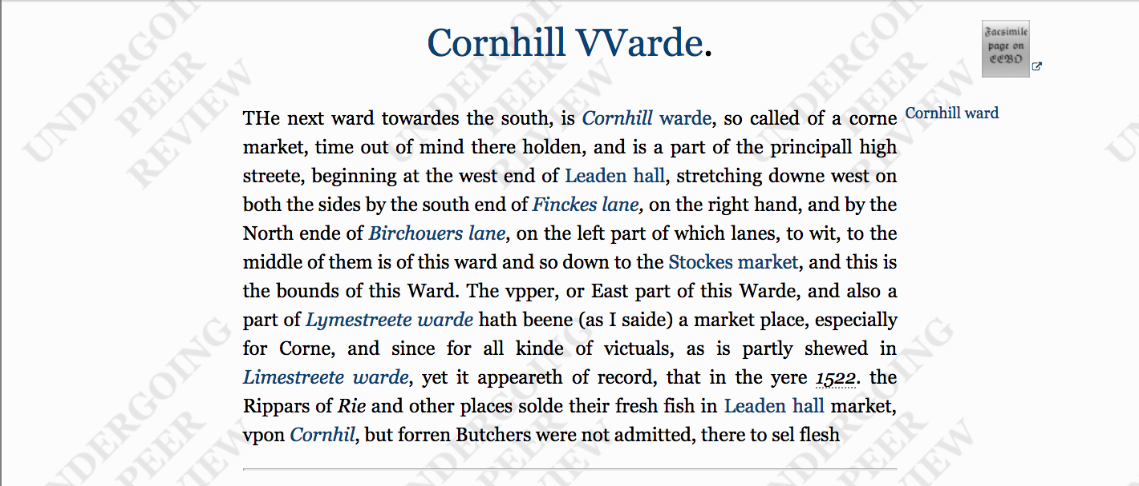

Slide 30
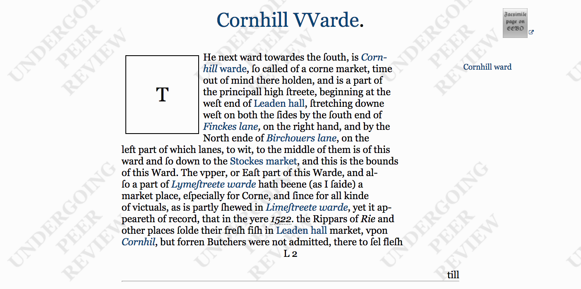

Slide 31
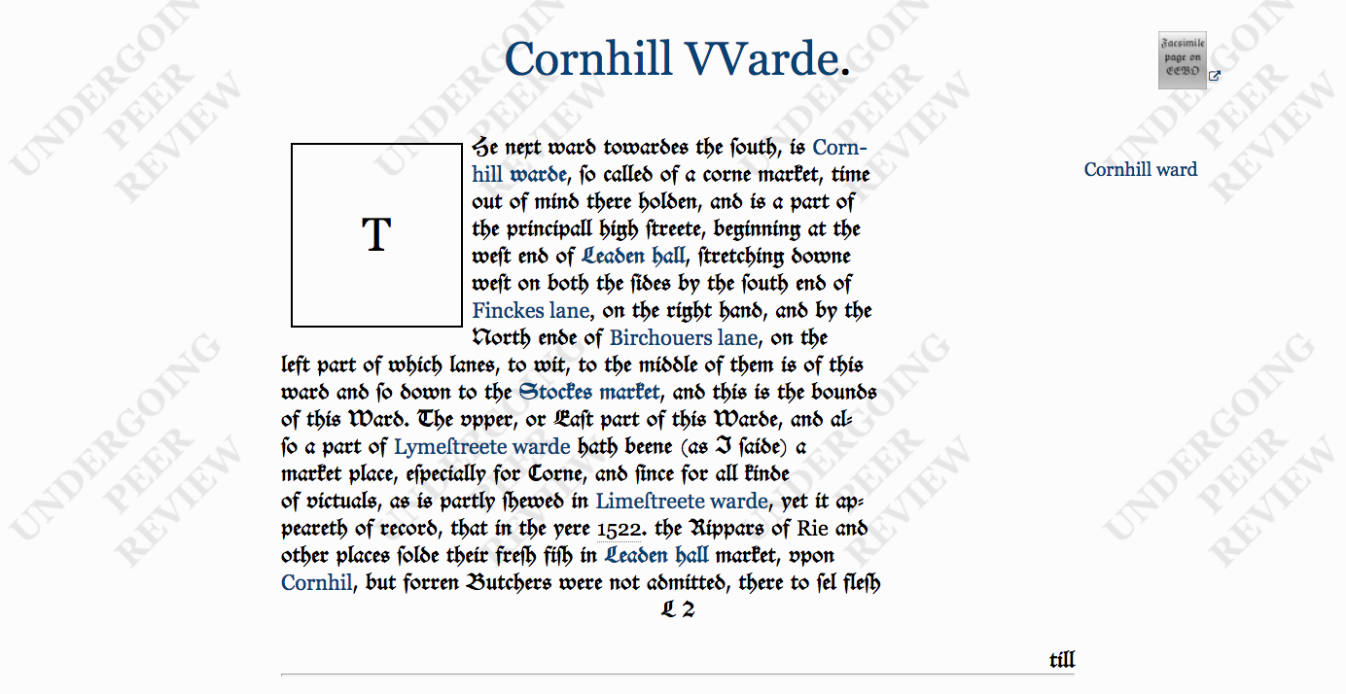

Slide 32
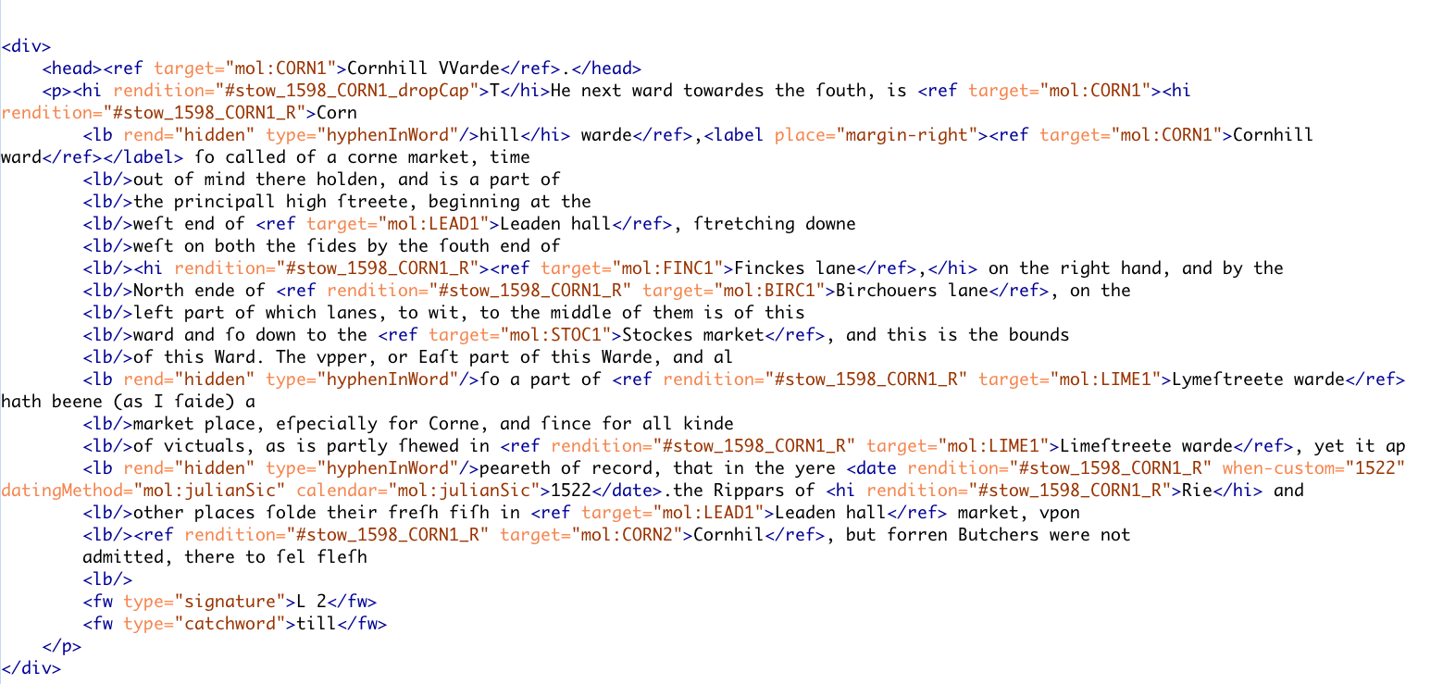

Slide 39
The TEI

Slide 40
The TEI
A set of guidelines for encoding text

Slide 41
The TEI
A set of guidelines for encoding text
A non-profit organization

Slide 42
The TEI
A set of guidelines for encoding text
A non-profit organization
A community or consortium of users

Slide 43
The TEI
A set of guidelines for encoding text
A non-profit organization
A community or consortium of users
Website: https://tei-c.org/

Slide 44
The TEI
Is a markup language written in XML

Slide 45
The TEI
Is a markup language written in XML
Currently in its 5th major revision (P5 3.3.1)

Slide 46
The TEI
Is a markup language written in XML
Currently in its 5th major revision (P5 3.3.1)
Offers a rich vocabulary and method to encode

Slide 47
The TEI
Is a markup language written in XML
Currently in its 5th major revision (P5 3.3.1)
Offers a rich vocabulary and method to encode
Bibliographic and structural features: page breaks, headers, footers, page numbers, line breaks, divisions, paragraphs, line groups, etc

Slide 48
The TEI
Is a markup language written in XML
Currently in its 5th major revision (P5 3.3.1)
Offers a rich vocabulary and method to encode
Bibliographic and structural features: page breaks, headers, footers, page numbers, line breaks, divisions, paragraphs, line groups, etc
Interpretative features: stage movement, emphasis, place names, proper names, dialogue direction, etc

Slide 49
The TEI
Is a markup language written in XML
Currently in its 5th major revision (P5 3.3.1)
Offers a rich vocabulary and method to encode
Bibliographic and structural features: page breaks, headers, footers, page numbers, line breaks, divisions, paragraphs, line groups, etc
Interpretative features: stage movement, emphasis, place names, proper names, dialogue direction, etc
Editorial apparatus: hands, witnesses, collation, gaps, additions, deletions, etc

Slide 50
The TEI
Is a markup language written in XML
Currently in its 5th major revision (P5 3.3.1)
Offers a rich vocabulary and method to encode
Bibliographic and structural features: page breaks, headers, footers, page numbers, line breaks, divisions, paragraphs, line groups, etc
Interpretative features: stage movement, emphasis, place names, proper names, dialogue direction, etc
Editorial apparatus: hands, witnesses, collation, gaps, additions, deletions, etc
Linguistic features: morphemes, feature structures, orthographic form, etc

Slide 51
The TEI
Is a markup language written in XML
Currently in its 5th major revision (P5 3.3.1)
Offers a rich vocabulary and method to encode
Bibliographic and structural features: page breaks, headers, footers, page numbers, line breaks, divisions, paragraphs, line groups, etc
Interpretative features: stage movement, emphasis, place names, proper names, dialogue direction, etc
Editorial apparatus: hands, witnesses, collation, gaps, additions, deletions, etc
Linguistic features: morphemes, feature structures, orthographic form, etc
Spoken features: incidents, pauses, shifts, ”communicative phenomenon”, etc

Slide 52
The TEI
Is a markup language written in XML
Currently in its 5th major revision (P5 3.3.1)
Offers a rich vocabulary and method to encode
Bibliographic and structural features: page breaks, headers, footers, page numbers, line breaks, divisions, paragraphs, line groups, etc
Interpretative features: stage movement, emphasis, place names, proper names, dialogue direction, etc
Editorial apparatus: hands, witnesses, collation, gaps, additions, deletions, etc
Linguistic features: morphemes, feature structures, orthographic form, etc
Spoken features: incidents, pauses, shifts, ”communicative phenomenon”, etc
Metadata: various classification schemes, provenance, manuscript description, etc
+++++

Slide 53
Quick History of the TEI

Slide 54
Quick History of the TEI
The Text Encoding Initiative (originally called the Guidelines for Text Encoding and Interchange)

Slide 55
Quick History of the TEI
The Text Encoding Initiative (originally called the Guidelines for Text Encoding and Interchange)
Started in the late 1980s in response to the boom in “humanities computing”

Slide 56
Quick History of the TEI
The Text Encoding Initiative (originally called the Guidelines for Text Encoding and Interchange)
Started in the late 1980s in response to the boom in “humanities computing”
Wanted to provide a framework and a set of principles for encoding texts that could be widely adopted

Slide 57
Within the noisy market place of the Digital Humanities, the TEI is a kind of senior member, an annoying parental figure for some, a benevolent one for others, something just too old-fashioned even to be considered for others. Yet, over the last decade, it has become increasingly clear that the TEI is part of what makes the digital humanities happen.
(Burnard, “Conclusion”, para. 1)

Slide 58
What the TEI is not

Slide 59
What the TEI is not
The TEI is not a language that describes how a text should be displayed online or in print. It should always concern the performative and expressive significance of the input, not the aesthetics of the output.

Slide 60
What the TEI is not
The TEI is not a language that describes how a text should be displayed online or in print. It should always concern the performative and expressive significance of the input, not the aesthetics of the output.
The TEI is not a programming language; that is, encoding your texts in TEI does not automatically do anything to them

Slide 61
What the TEI is not
The TEI is not a language that describes how a text should be displayed online or in print. It should always concern the performative and expressive significance of the input, not the aesthetics of the output.
The TEI is not a programming language; that is, encoding your texts in TEI does not automatically do anything to them
Caveat: There are many, many tools for transforming TEI into other formats (Word documents, PDFs, and, of course, websites)

Slide 62
XML

Slide 63
XML
The TEI is written in XML (eXtensible Markup Language)

Slide 64
XML
The TEI is written in XML (eXtensible Markup Language)
XML is not a set language unto itself, but a grammar

Slide 65
XML
The TEI is written in XML (eXtensible Markup Language)
XML is not a set language unto itself, but a grammar
XML is hierarchical

Slide 66
XML
The TEI is written in XML (eXtensible Markup Language)
XML is not a set language unto itself, but a grammar
XML is hierarchical
XML is a tree-like structure

Slide 67
XML
The TEI is written in XML (eXtensible Markup Language)
XML is not a set language unto itself, but a grammar
XML is hierarchical
XML is a tree-like structure
And is often described in genealogical terms

Slide 68
XML
Think of the hierarchy of the book:

Slide 69
XML
Think of the hierarchy of the book:
Book

Slide 70
XML
Think of the hierarchy of the book:
Book
Chapters

Slide 71
XML
Think of the hierarchy of the book:
Book
Chapters
Sections

Slide 72
XML
Think of the hierarchy of the book:
Book
Chapters
Sections
Paragraphs

Slide 73
XML
Think of the hierarchy of the book:
Book
Chapters
Sections
Paragraphs
Sentences

Slide 74
XML
Think of the hierarchy of the book:
Book
Chapters
Sections
Paragraphs
Sentences
Words

Slide 75
XML
Think of the hierarchy of the book:
Book
Chapters
Sections
Paragraphs
Sentences
Words
Letters

Slide 76
XML

Slide 77
XML
<book> <chapter> <section type=“subsection”> <paragraph> <sentence> <word> <letter></letter> </word> </sentence> </paragraph> </section> </chapter> </book>

Slide 78
XML
<book> <chapter> <section type=“subsection”> <paragraph> <sentence> <word> <letter></letter> </word> </sentence> </paragraph> </section> </chapter> </book>

Slide 79
XML
<book> <chapter> <section type=“subsection”> <paragraph> <sentence> <word> <letter></letter> </word> </sentence> </paragraph> </section> </chapter> </book>

Slide 80
XML
<book> <chapter> <section type=“subsection”> <paragraph> <sentence> <word> <letter></letter> </word> </sentence> </paragraph> </section> </chapter> </book>

Slide 81
XML
<book> <chapter> <section type=“subsection”> <paragraph> <sentence> <word> <letter></letter> </word> </sentence> </paragraph> </section> </chapter> </book>

Slide 82
XML
<book> <chapter> <section type=“subsection”> <paragraph> <sentence> <word> <letter></letter> </word> </sentence> </paragraph> </section> </chapter> </book>

Slide 83
XML
<book> <chapter> <section type=“subsection”> <paragraph> <sentence> <word> <letter></letter> </word> </sentence> </paragraph> </section> </chapter> </book>

Slide 84
XML Explained

Slide 85
XML Explained
The two pointy brackets is called an element
E.g. <book> would be called the book element

Slide 86
XML Explained
The two pointy brackets is called an element
E.g. <book> would be called the book element
All elements have start and end tags
E.g. <book> is the start tag and </book> is the end tag

Slide 87
XML Explained
The two pointy brackets is called an element
E.g. <book> would be called the book element
All elements have start and end tags
E.g. <book> is the start tag and </book> is the end tag

Slide 88
XML Explained
The two pointy brackets is called an element
E.g. <book> would be called the book element
All elements have start and end tags
E.g. <book> is the start tag and </book> is the end tag
Elements can also have attributes and each attribute must have a value
E.g. <book type= “primary”> has a type attribute with the value of primary
(Think of attributes as you would in everyday life; people don’t have “height” or “age” without a value)

Slide 89
XML Explained

Slide 90
XML Explained
Elements cannot overlap
<sentence><word>Word1</word></sentence> is right
<sentence><word>Word1</sentence></word> is wrong

Slide 91
XML Explained
Elements cannot overlap
<sentence><word>Word1</word></sentence> is right
<sentence><word>Word1</sentence></word> is wrong
Elements nest and use genealogical terms
I.e this bit of XML
<book>
<chapter></chapter>
</book>
Can be described as “chapter is a child of book” OR “book is a parent of chapter”

Slide 92
XML Explained
Elements cannot overlap
<sentence><word>Word1</word></sentence> is right
<sentence><word>Word1</sentence></word> is wrong
Elements nest and use genealogical terms
I.e this bit of XML
<book>
<chapter></chapter>
</book>
Can be described as “chapter is a child of book” OR “book is a parent of chapter”
There is always a root element
That is, there is always one element that encloses everything

Slide 93
The Problem
I just wrote that XML to describe a book
How else could it be written?

Slide 94
The Problem
I just wrote that XML to describe a book
How else could it be written?
<book> <ch> <para> <w> <c></c> </w> </para> </ch> </book>

Slide 95
The TEI Solution

Slide 96
The TEI Solution
All texts must be called <text>

Slide 97
The TEI Solution
All texts must be called <text>
All divisions (whether they be chapters, sections, et cetera) must be called <div>

Slide 98
The TEI Solution
All texts must be called <text>
All divisions (whether they be chapters, sections, et cetera) must be called <div>
All paragraphs must be called <p>

Slide 99
The TEI Solution
All texts must be called <text>
All divisions (whether they be chapters, sections, et cetera) must be called <div>
All paragraphs must be called <p>
All words must be called <w>

Slide 100
The TEI Solution
All texts must be called <text>
All divisions (whether they be chapters, sections, et cetera) must be called <div>
All paragraphs must be called <p>
All words must be called <w>
+++

Slide 101
Components of a (basic) TEI file

Slide 102
Components of a (basic) TEI file
Root <TEI> element

Slide 103
Components of a (basic) TEI file
Root <TEI> element
A <teiHeader> that describes both the file and the primary source that you are transcribing (if applicable)

Slide 104
Components of a (basic) TEI file
Root <TEI> element
A <teiHeader> that describes both the file and the primary source that you are transcribing (if applicable)
A <text> that contains the text of the document
Within text, you can have a <front>, <body>, or <back>

Slide 105
TEI is for Data and Metadata
<TEI>
<teiHeader>
</teiHeader>
<text>
</text>
</TEI>
metadata
data

Slide 106
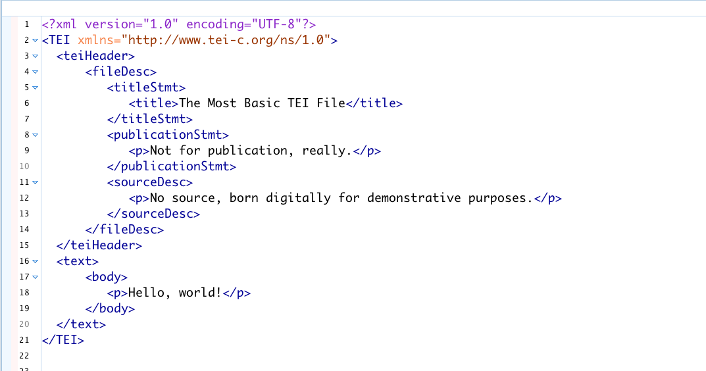
Basic TEI File

Slide 107
TEI

Slide 108
TEI
Note that the TEI is huge (569 elements)

Slide 109
TEI
Note that the TEI is huge (569 elements)
No one uses the entirety of the TEI tagset

Slide 110
TEI
Note that the TEI is huge (569 elements)
No one uses the entirety of the TEI tagset
Individual projects customize the TEI for their own needs, usually using a small subset of the overall tagset (more on this in Workshop #2 in October!)
E.g. Drama projects will use the drama tagset (<sp> for speech, <speaker> for speaker, et cetera) and discard the linguistic/dictionary tagset (<entry> for dictionary entries, <m> for morpheme, etc).

Slide 111
That was A LOT of information in a very short time
Any questions?

Slide 112
Sample TEI Projects

Slide 113
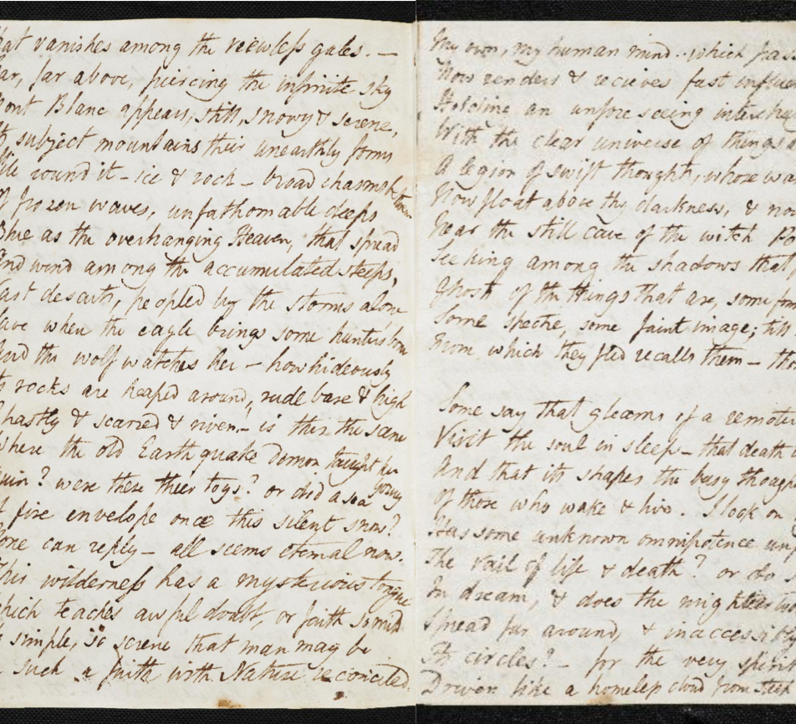
The Shelley-Godwin Archive

Slide 114
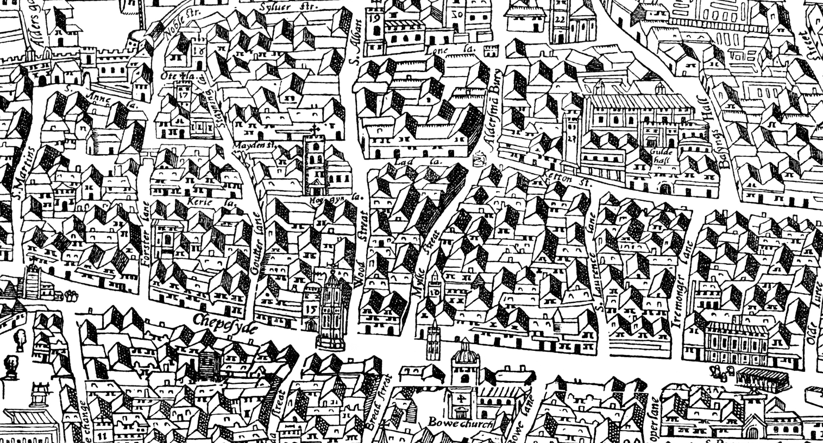
The Map of Early Modern London

Slide 115
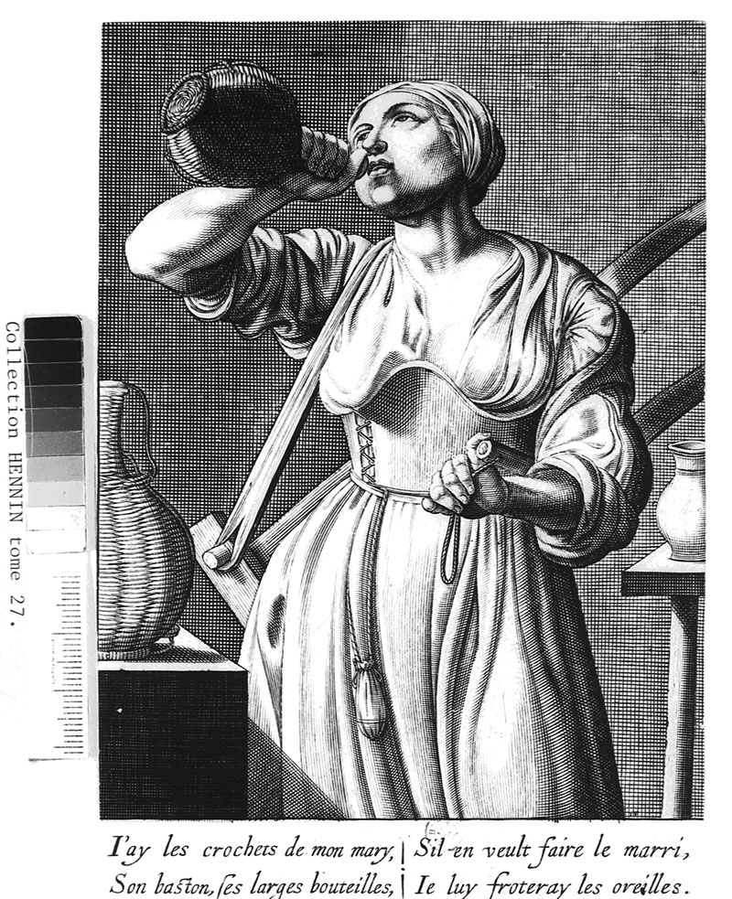
Le Mariage

Slide 116
He Do the Police in Different Voices

Slide 117
Resources
The TEI’s website: https://tei-c.org
TEI by Example: http://teibyexample.org/
Lou Burnard, What is the Text Encoding Initiative?: https://books.openedition.org/oep/679?lang=en
Teach Yourself TEI: http://www.tei-c.org/support/learn/teach-yourself-tei/
DHSI @ Uvic: http://www.dhsi.org/courses.php

Slide 118
Next Workshop
October 20, 2018
Focus will be on tools for working with and deploying TEI
Please bring a text (doesn’t have to be a primary source text—it can be a journal article or an essay!)

Slide 119
Thanks!
UBC Libraries, esp. Allan Cho for the invitation!
Martin Holmes, Janelle Jenstad, The Endings Project, and Uvic’s Humanities Media and Computing Center

